Slide 1
UNIT-3 Digital Image Processing

Slide 2
Image → 2D function → f(x, y)
X, y → Spatial Coordinates
Amplitude of f→ intensity or gray level
X, y and amplitude of f → discrete or finite values→ “DIGITAL IMAGE”
DIGITAL IMAGE PROCESSING
Processing of digital image → digital computer
Consists of finite elements → location and values.
Finite elements also known as picture elements, pels, pixels, image elements.
Vision → advance senses→ limited to “visual bands”
EMS → GAMMA RAYS TO RADIO WAVES
Image mechanics→ used for image processing
DIP → covers wide and varied fields of applications

Slide 3
TYPES OF DIP
Image → DIP SYSTEM → image (low level process)
EX: Noise image→ DIP SYTEM→ CLEAR IMAGE (NOISE IS REDUCED)
Image → DIP SYSTEM→ attributes (mid level process)
EX: Object recognition
Attributes → DIP SYSTEM → Understanding (making sense) (High –level process)
EX: Ball image → DIP SYSTEM → identify the image as ball.

Slide 4
What Is Digital Image Processing?
The field of digital image processing refers to processing digital images by means of a digital computer.
y
f(x,y)
x

Slide 5
What is a Digital Image ?
An image may be defined as a two- dimensional function, f(x,y) where x and y are spatial (plane) coordinates, and the amplitude of f at any pair of coordinates (x, y) is called the intensity or gray level of the image at that point.
When x, y, and the amplitude values of f are all finite, discrete quantities, we call the image a digital image.

Slide 6
Picture elements, Image elements, pels and pixels
A digital image is composed of a finite number of elements, each of which has a particular location and value.
• These elements are referred to as picture elements, image elements, pels, and pixels.
• Pixel is the term most widely used to denote the elements of a digital image.

Slide 7
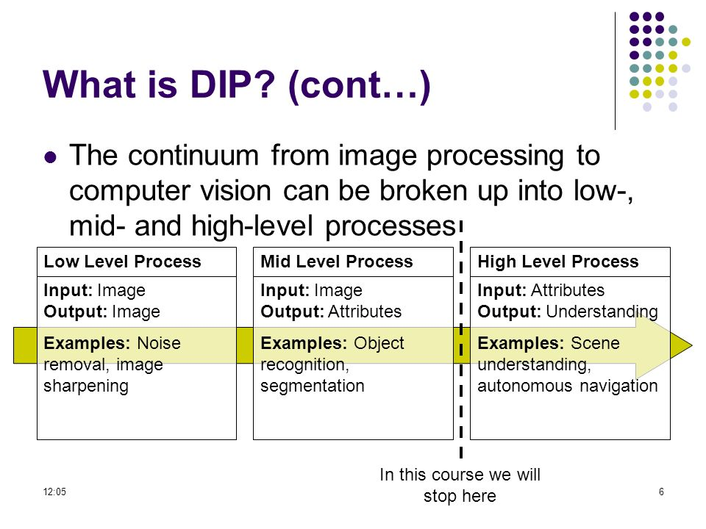

Slide 8
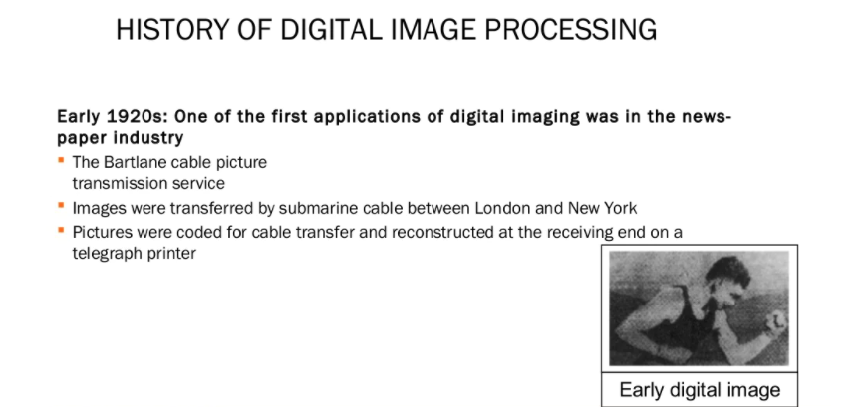
The Origins of Digital Image Processing

Slide 9
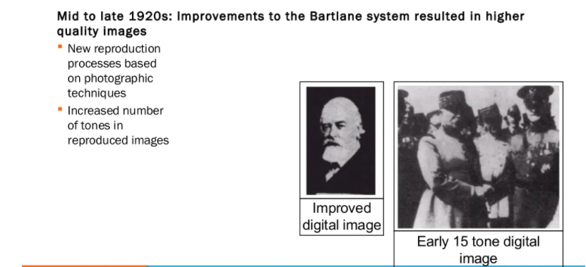

Slide 10
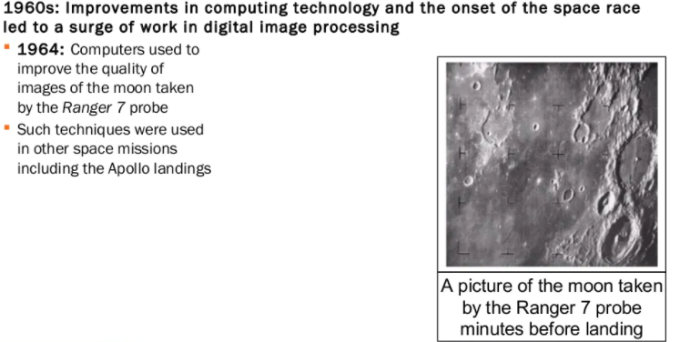

Slide 11
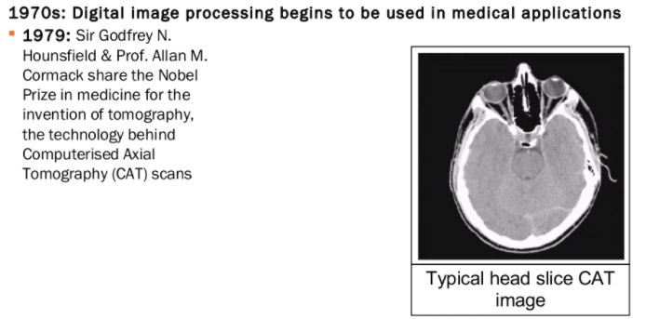

Slide 12
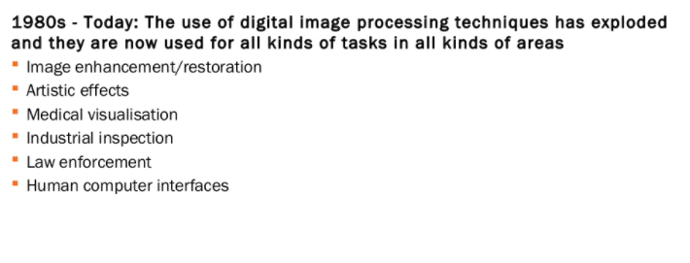

Slide 13
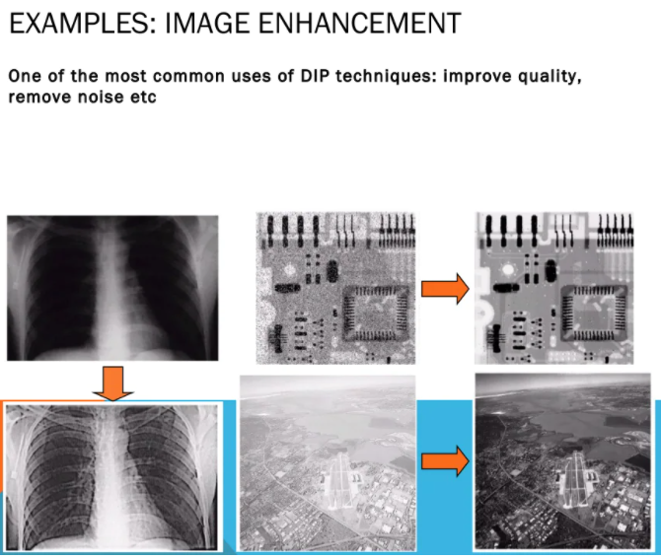

Slide 14
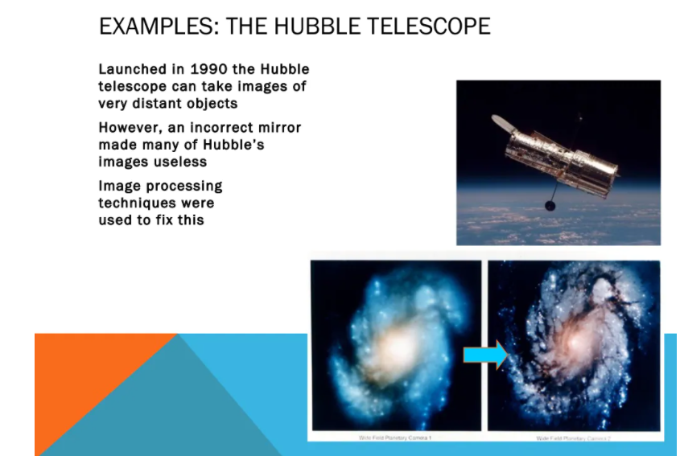

Slide 15
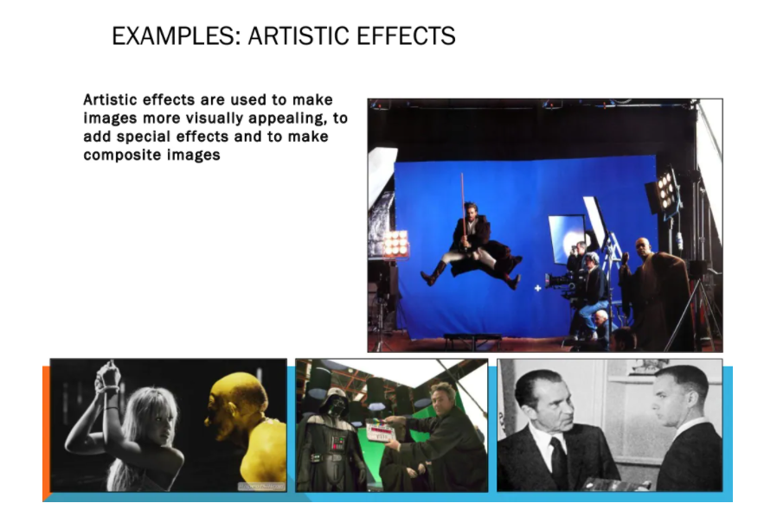

Slide 16
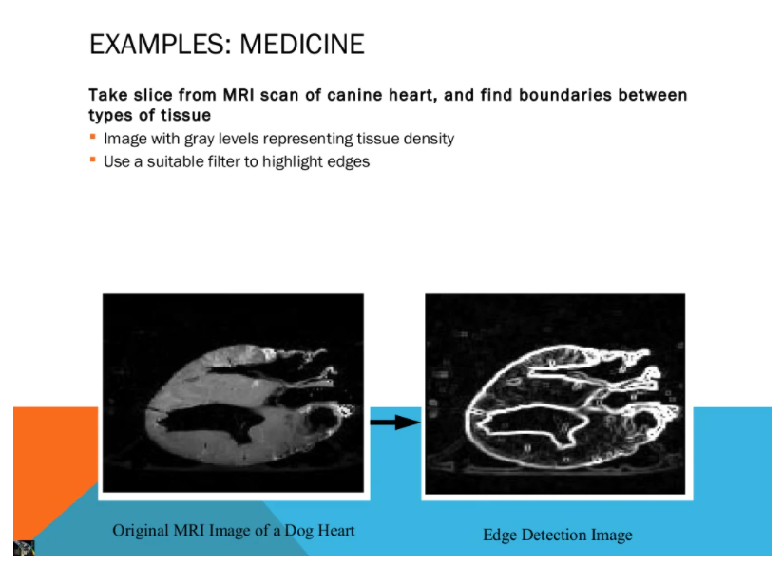

Slide 17
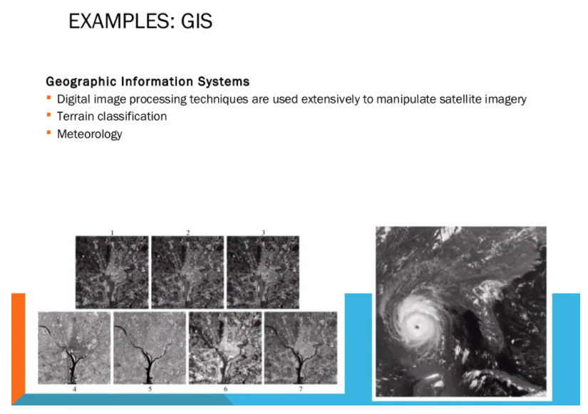

Slide 18
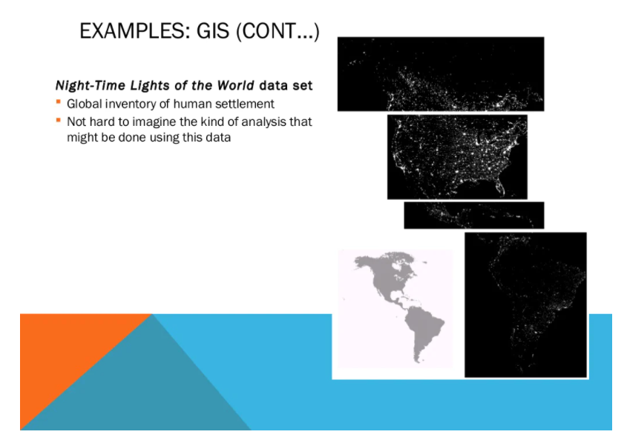

Slide 19
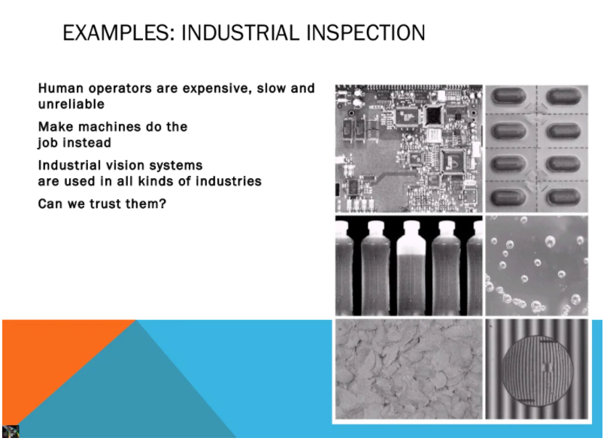

Slide 20
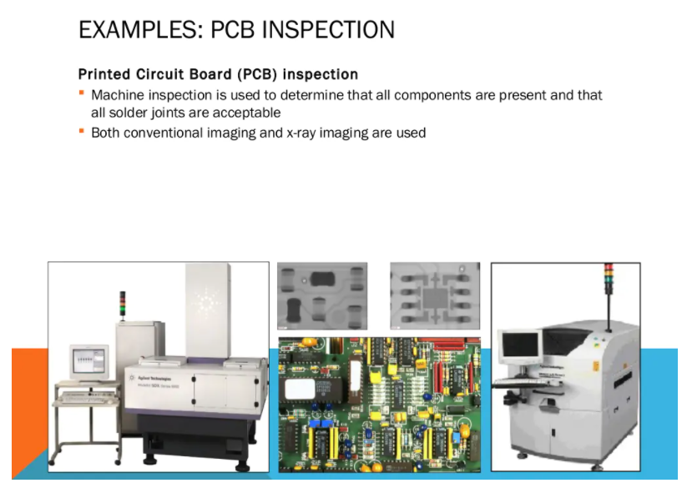

Slide 21
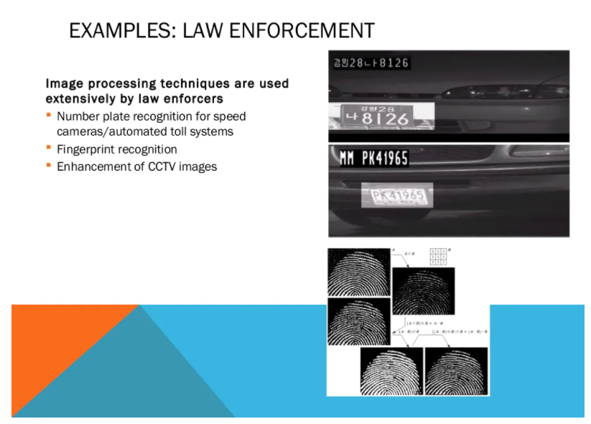

Slide 22
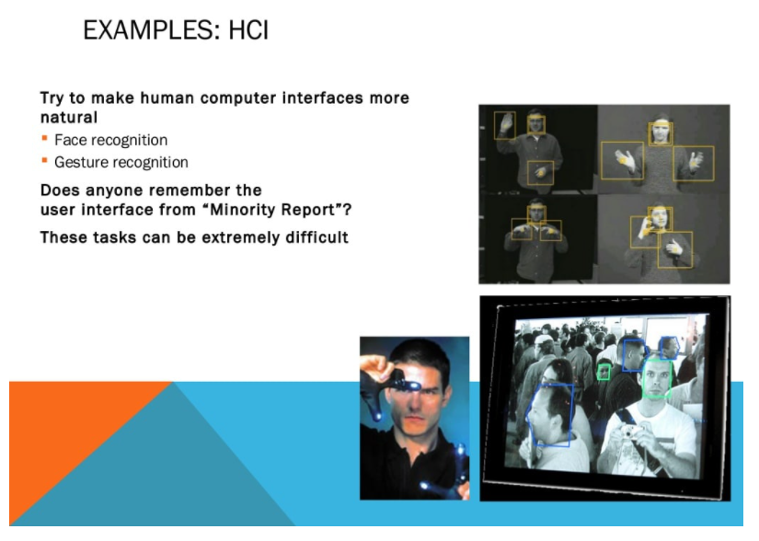

Slide 23
Examples of Fields that use Digital Image Processing
A digital image is a representation of a two- dimensional image as a finite set of digital values, called picture elements or pixels.
Fields in DIP:
Gamma Rays
X-Rays
Ultraviolet Rays
Visible and Infrared Rays
Microwave Rays
Radio Band

Slide 24
Gamma Rays
Gamma Rays are used in Medicine and Astronomical Observations.
It is also used in Bone Pathology.
It is used to find the Tumor and Infections in our body.
In Nuclear Medicine, Rays are passed into our body with a Radioactive isotope that emits gamma rays as it decays.
The images are produced and they are collected by Gamma Ray Detectors.

Slide 25
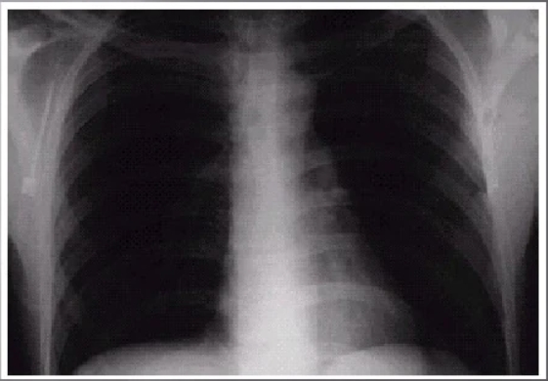
X-Rays
It is used widely in:
Medical Diagnostics
Astronomy
In Medical Diagnostics, Rays are generated using X-Ray tube, which is a Vacuum Tube with a Cathode and Anode.

Slide 26
ANGIOGRAPHY, is used to obtain images about the Blood Vessels.
Catheter is small, flexible and hollow tube.
Higher energy X-Rays are used in Industrial processes.

Slide 27
Ultraviolet Band
UV Rays are widely used in:
Lithography
Industrial Inspection
Microscopy
Lasers
Biological Imaging
Astronomical Observations

Slide 28
UV lights are used in Fluorescence microscopy.
It is one of the fastest growing areas of Microscopy.
Fluorescence is a method discovered in the middle nineteenth century.
The UV Rays are not visible. When a photon of UV radiations collides with an electron in an atom of fluorescent produces electrons with lots of energy.

Slide 29
Visible and Infrared Bands
Microscope allows us to see any tiny images with a well detailed form.
Even at times objects viewed through a Microscope will not provide any clear ideas about the objects.
To provide a competition to it and view in a well detailed manner another major area is used in visual processing called Visual and Infrared rays.

Slide 30
Infrared and Visible rays plays an important role such as:
1.Microscopy
2.Astronomy
3.Remote Sensing
4.Industry
5.Law Enforcement

Slide 31
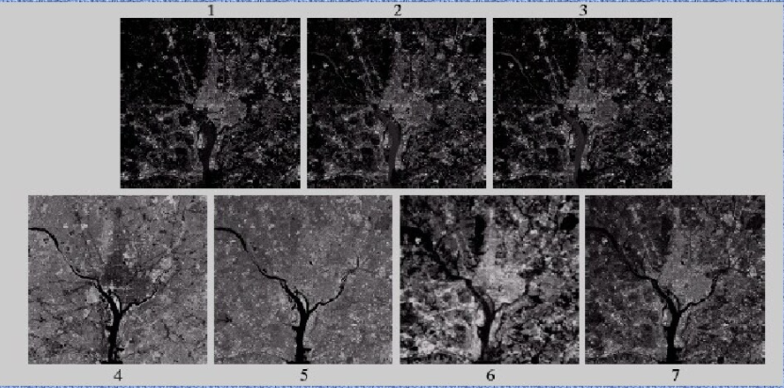
The above image is taken from the satellite , which is a image view of Washington D.C., where each image represents features such as Buildings, roads, vegetation and rivers.
4th and 5th images are taken from Visible rays which can be easily identified by our eyes.

Slide 32
NASA’s LANDSAT satellite’s main function is to obtain and send images of Earth from Space.
The Bands are expressed in terms of WAVELENGTH.

Slide 33
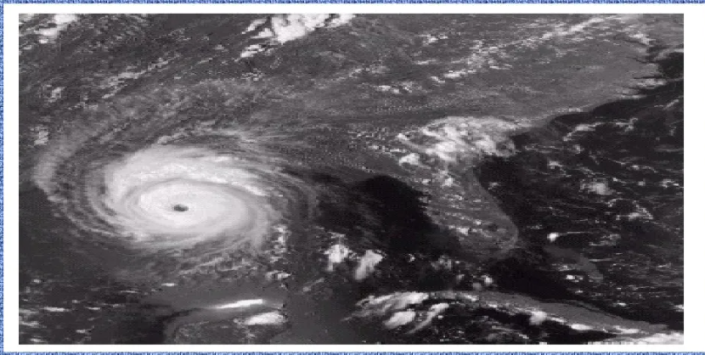
The image is taken from space which states about Hurricane.
Taken by a NATIONAL OCEANOGRAPHIC and ATMOSPHERIC ADMINISTRATION (NOAA) they used Visible and Infrared rays.

Slide 34
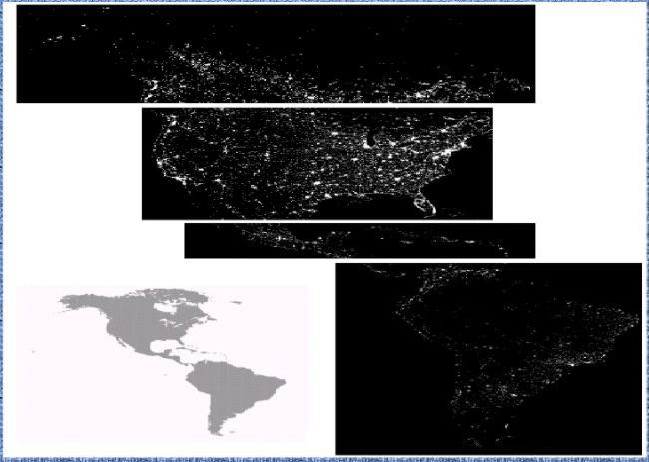
The images obtained illustrates an application of Infrared Imaging.
These images are generated by the Infrared imaging system mounted on a NOAA Defense Meteorological Satellite Program (DMSP).

Slide 35
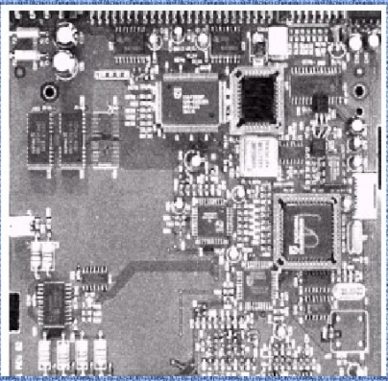
This image is a controller board for a
CD-ROM, a typical processing task with
this product is to find or inspect
missing parts.

Slide 36
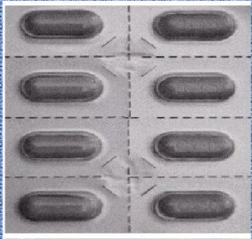
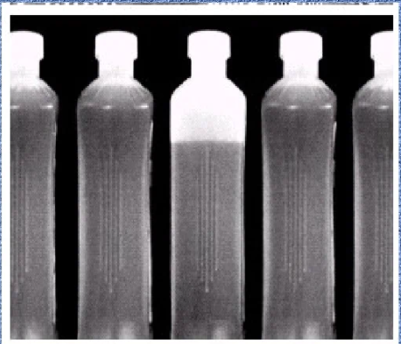
The idea is to find missing capsule.
In this image we can find the bottle
with unacceptable liquid level.

Slide 37
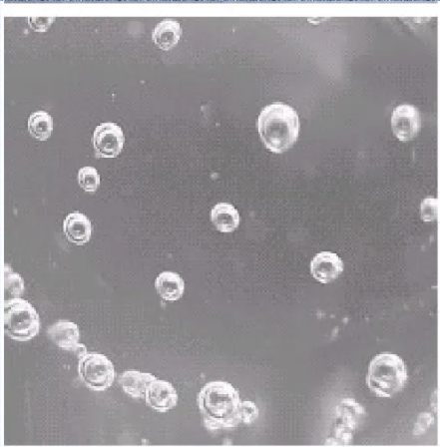
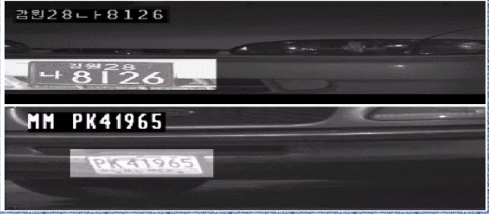
A clear plastic part with an unacceptable
number of air pockets in it.
Image Processing techniques are used
extensively by law enforcers.
Number plate recognition for speed
cameras / automated toll systems.

Slide 38
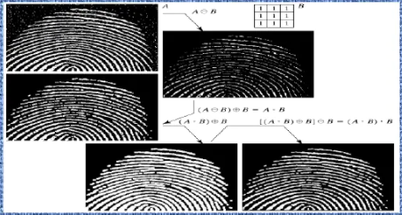
It is very useful in finding the difference between each and every finger print which are much useful in Forensic reports.

Slide 39
Microwave Band:
The dominant application of imaging in the Microwave band is Radar.
The very important feature of imaging Radar is its ability to collect data virtually from any region at any time, in any weather or any light condition.
Some Radar waves can penetrate through clouds and also penetrate through vegetation and icy regions.

Slide 40
How Radar waves are generated?
Instead of a camera lens, a radar uses an antenna and Digital Computer Processing to record images.
In a Radar image, one can see only a Microwave energy that reflected from the Radar Antenna.

Slide 41
Radio Band
Major uses of Radio bands:
Medicine
Astronomy
Medicine:
Radio waves are used in Magnetic Resonance Imaging(MRI).This technique places the patients in a powerful magnet and passes Radio waves through their body in very short pulses(in seconds).
Each pulse causes a responding pulse of Radio waves to be emitted by the patients tissues.
The location is then identified by the computer which produces a 2-Dimensional picture.
These MRI’s can be used to take pictures in any plane.

Slide 42
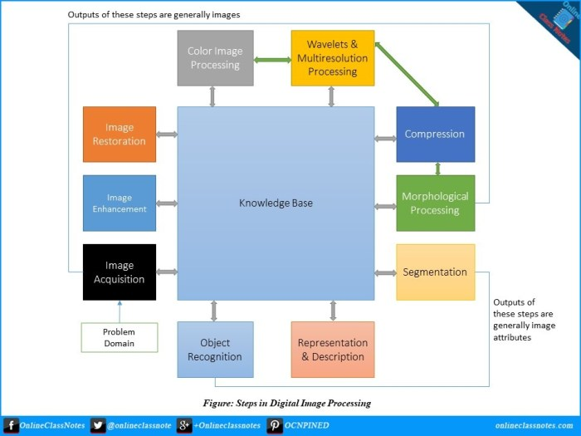
Fundamental Steps of Digital Image Processing

Slide 43
1.Image Acquisition:
It is the first step of the fundamental steps of DIP. In this stage, an image is given in the digital form. Generally, in this stage, pre-processing such as scaling is done.
2.Image enhancement:
It is the simplest and most attractive area of DIP. In this stage details which are not known, or we can say that interesting features of an image is highlighted. Such as brightness, contrast, etc...
3. Image Restoration:
Image restoration is the stage in which the appearance of an image is improved.

Slide 44
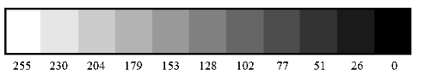
What is an image?
A two-dimensional array of numbers(or pixels) ranging between 0 and 255.
It is defined by the mathematical function f(x,y) where x and y are the two co-ordinates horizontally and vertically.
The range of the colors in 8 bit vary from 0–255 where:
0 — black
255 — white
127 — gray color.

Slide 45
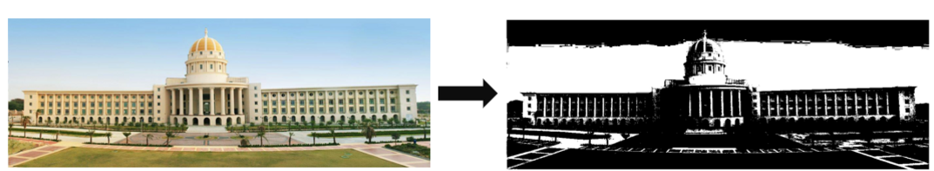
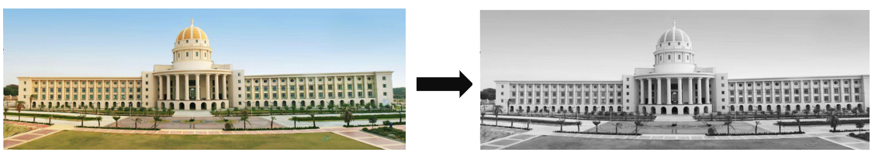
What is a black and white image?
The image consists of black and white color only.
What are greyscaled images?
It is a black and white image, but the name emphasizes that such an image will also include many shades of grey.
The values ranging between 0 and 255.

Slide 46
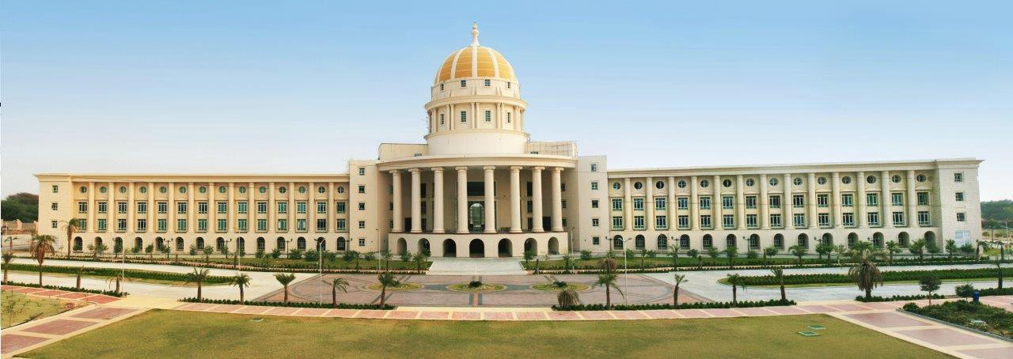
Image Acquisition
It is basically capturing an image.
Generally, the image acquisition stage involves pre-processing, such as scaling, etc.

Slide 47
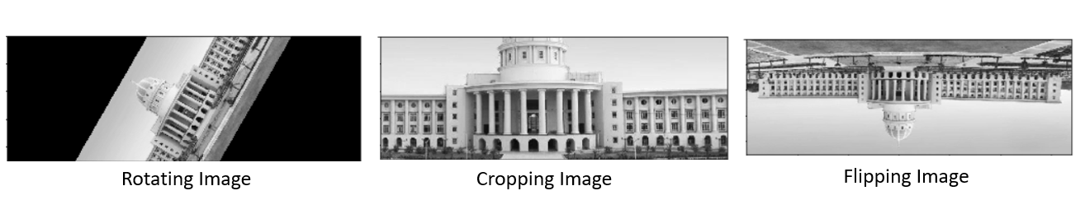
Basic operations on Image

Slide 48
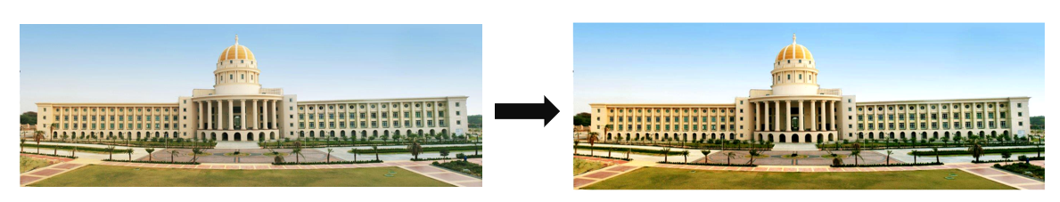
Image Enhancement
It is the process of filtering image(removing noise, increasing contrast, etc) to improve the quality.
The resulting image will be more suitable than the original image.

Slide 49
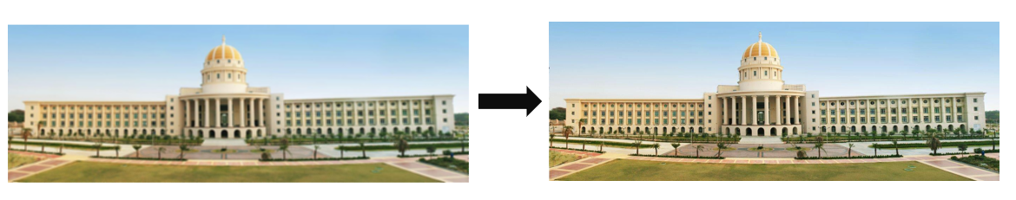
Image Restoration
It is the process of improving appearance (reducing blurring etc) of an image by mathematical or probabilistic models.

Slide 50
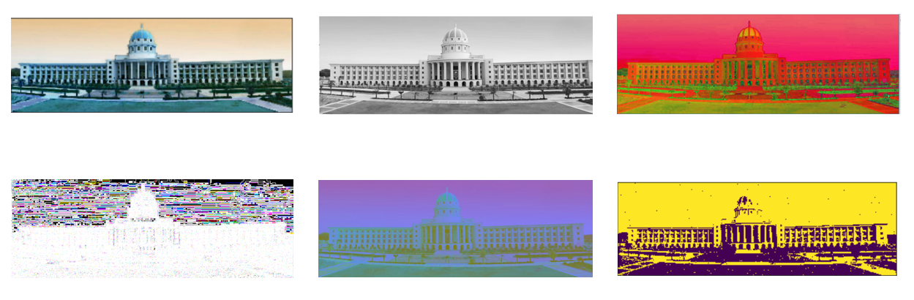
Color Image Processing
It has become more popular since the use of the digital image has increased.

Slide 51
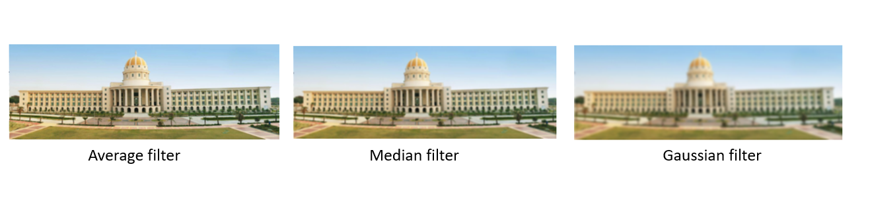
Multi-Resolution Processing
It is the process of representing images in various degrees of resolution.

Slide 52
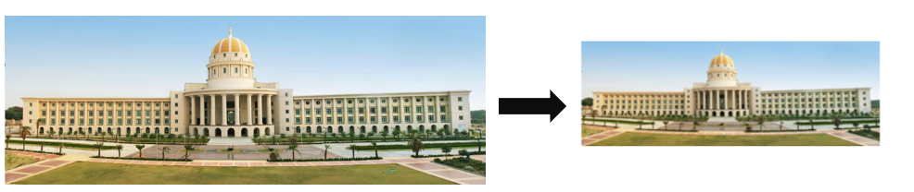
Compression
It involves the techniques for reducing the size of the image with minimum in its quality.

Slide 53
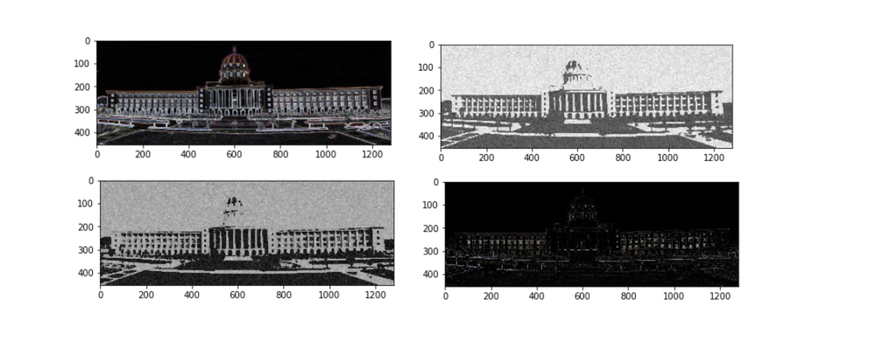
Morphological Processing
It is the process for extracting image components that are useful in the representation and description of shape.

Slide 54
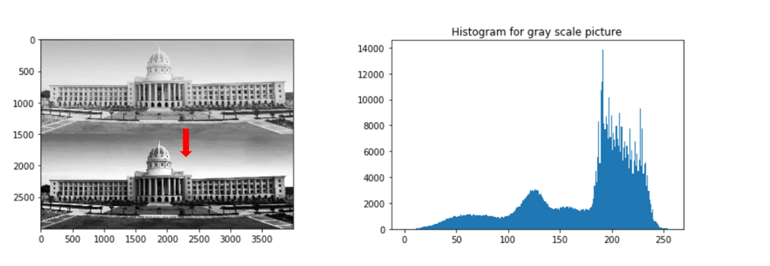
Segmentation
It is the process of partitioning the image into multiple segments.

Slide 55
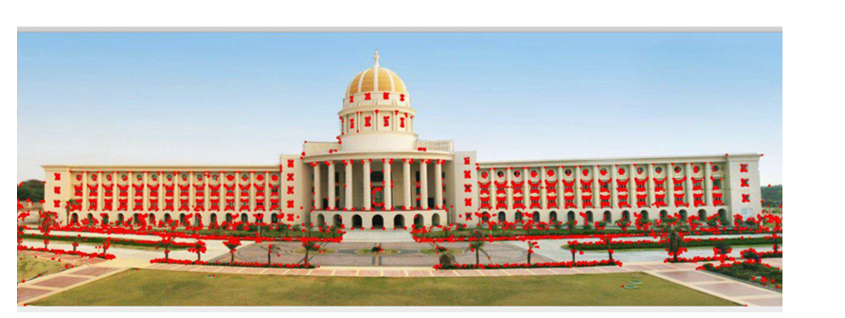
Representation and Description
It involves representing an image in various forms:
Boundary Representation — It focuses on the external shape characteristics such as corners and inflections.
Regional Representation — It focuses on internal properties such as texture and skeletal shape.

Slide 56
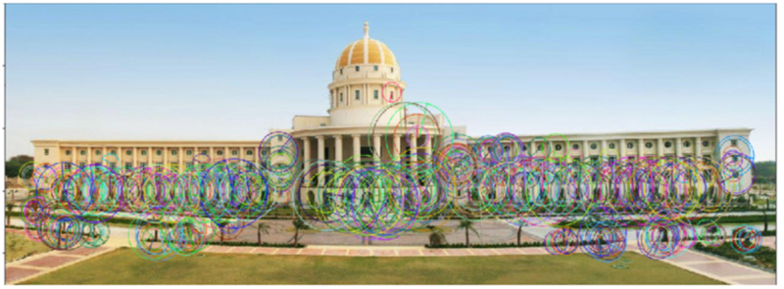
Description aka Feature selection helps in extracting useful information.

Slide 57
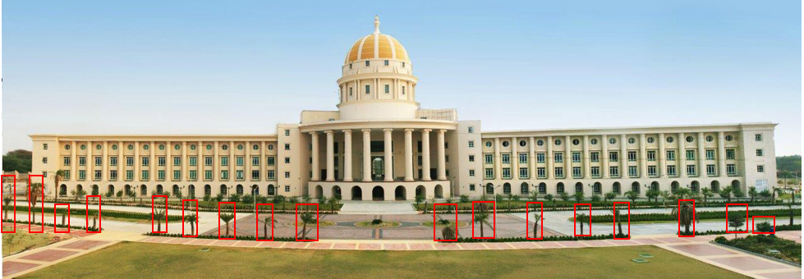
Recognition
It is the process of assigning labels to an object based on its description.

Slide 58
A problem domain is the area of expertise or application that needs to be examined to solve a problem

Slide 59
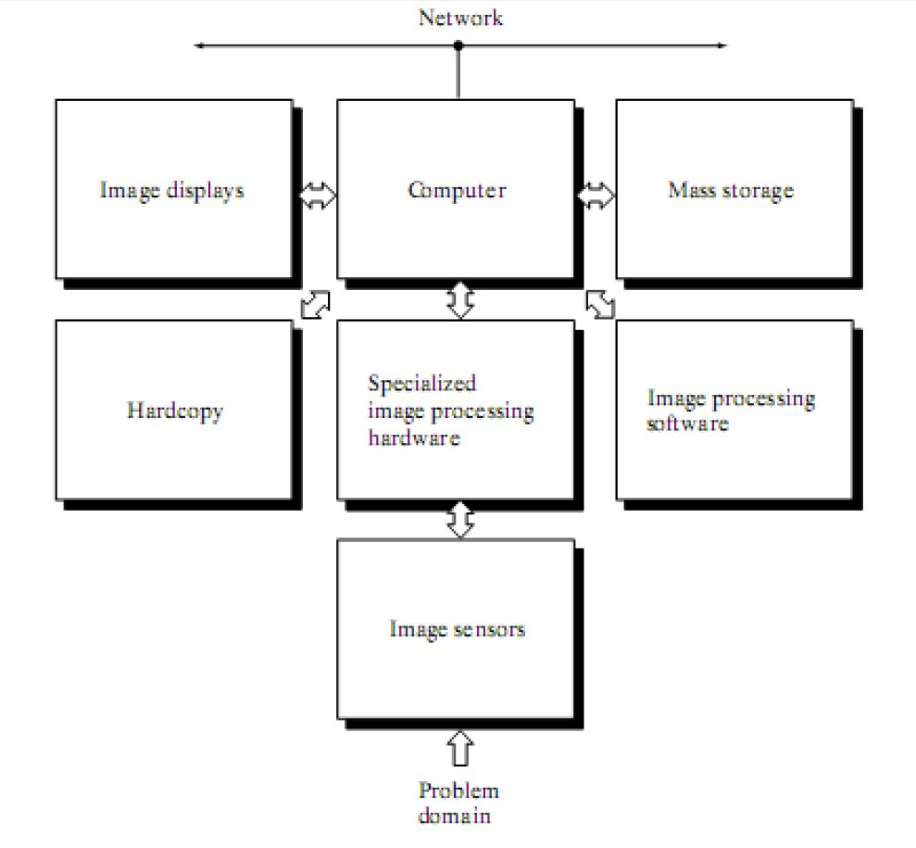
Components of Image Processing System

Slide 60
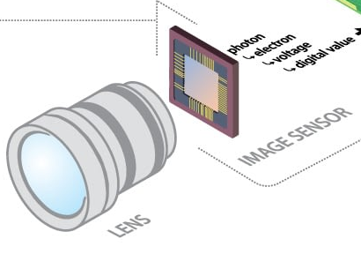

Slide 61
Image sensors:
Image sensors → senses the intensity, amplitude, co-ordinates and other features of the images → passes the result to the image processing hardware → It includes the problem domain.
CCD (Charged Coupled Device) and CMOS (Complementary Metal-Oxide Conductor) image sensors →widely used in image-capturing devices like digital cameras.
Two elements required(physical device and digitizer) → to acquire digital images
Physical device → sensor
Digitizer means → for converting output of physical sensing device into digital form.
Image Processing Hardware:
It is the dedicated hardware → used to process the instructions obtained from the image sensors. → It passes the result to general purpose computer.

Slide 62
Computer:
Computer used in the image processing system → is the general purpose computer that is used by us in our daily life.
Image Processing Software:
It is the software → that includes all the mechanisms and algorithms → that are used in image processing system.
Mass storage:
Mass storage → stores the pixels of the images during the processing.

Slide 63
Hard copy Device:
Once the image is processed → then it is stored in the hard copy device.→ It can be a pen drive or any external ROM device.
Image Display:
It includes the monitor or display screen that → displays the processed images.
Network:
It is the connection of all the above elements of the image processing system.

